Slide 1
Mass Timber Frame Construction
Mike Neubauer, Technical AVP, Casualty Underwriting
RLI Insurance Company

Slide 2
What is Mass Timber?
Mass Timber is the formation of large panels, posts and beams created by the laminating of wood products through the use of glue, nails, and dowels. These engineered wood products start as regular dimensional lumber, but are then combined in a layering or laminating process.
Mass Timber Construction uses these Mass Timber products in applications seen more commonly in steel or concrete structures.

Slide 3
Mass Timber Examples
The Ascent
  The current world’s Tallest Mass Timber structure.
    284 feet tall, 25-story luxury apartment building in Milwaukee, Wisconsin.
    Occupancy started in July 2022.
    https://www.ascentmke.com/
111 East Grand
  111 East Grand is a 4-story, 65,000 sq.ft. office building in the East Village area of Des Moines. Completed in 2019.
  The first Mass Timber building in Iowa & first use of Dowel Laminated Timber (DLT) for the floors and roof deck in a multi-story office building in North America.
  Uses Gluelam posts and beams.
  https://structurecraft.com/projects/east-grand-office

Slide 4
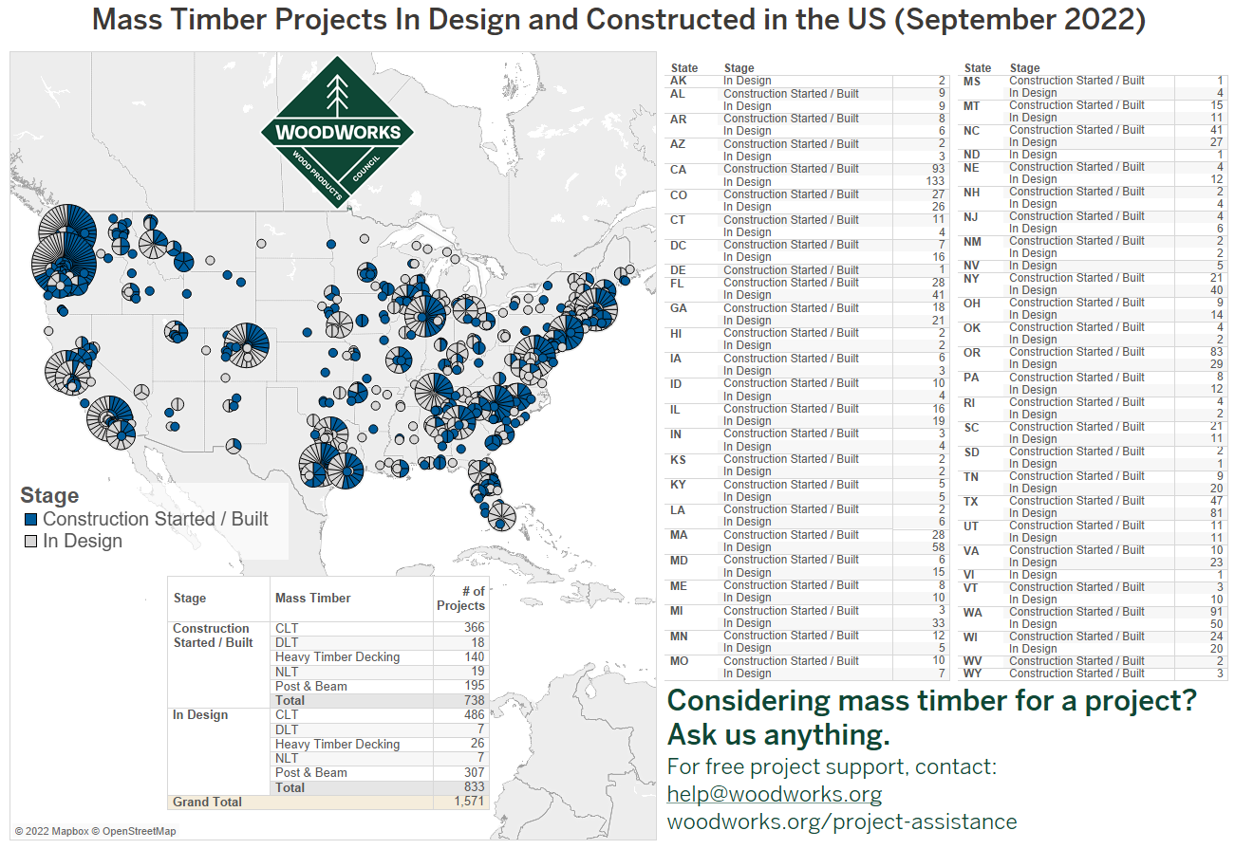
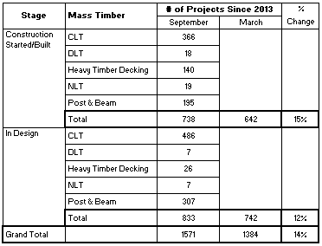

Slide 5
How is Mass Timber Different than Light Frame
The differences between Mass Timber and typical Frame Construction comes from the composition of the structural components, the size of the structural members, and the distances between the individual vertical and horizontal components.
With Light Frame Construction much of the load bearing vertical components are individual pieces solid wood dimensional lumber, such as 2x4’s, or 2x6’s set 16 or 24 inches apart.
The Light Frame Construction horizontal load bearing components may be made of dimensional lumber or engineered lumber. Engineered lumber components are used to increase the distances these components can span from end to end, but are still typically placed 16 or 24 inches apart in the case of floor joists. You will often see Laminated Veneer Lumber (LVL) beams used as a header over a garage door or a wide opening in a wall.

Slide 6
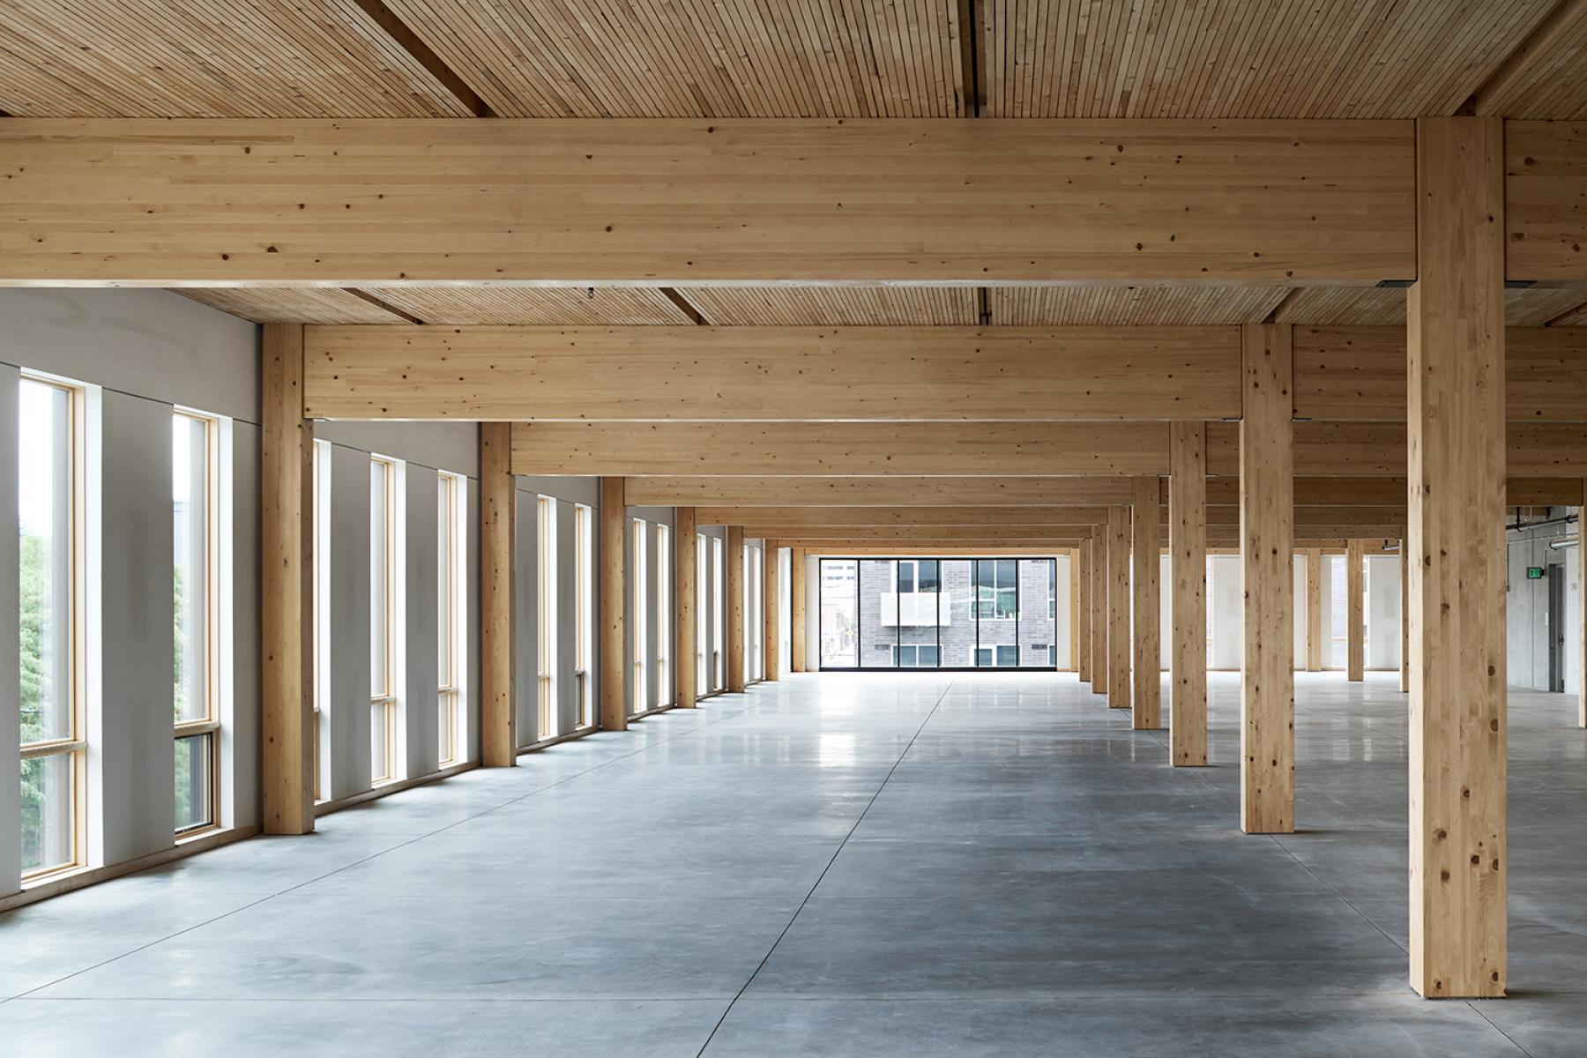
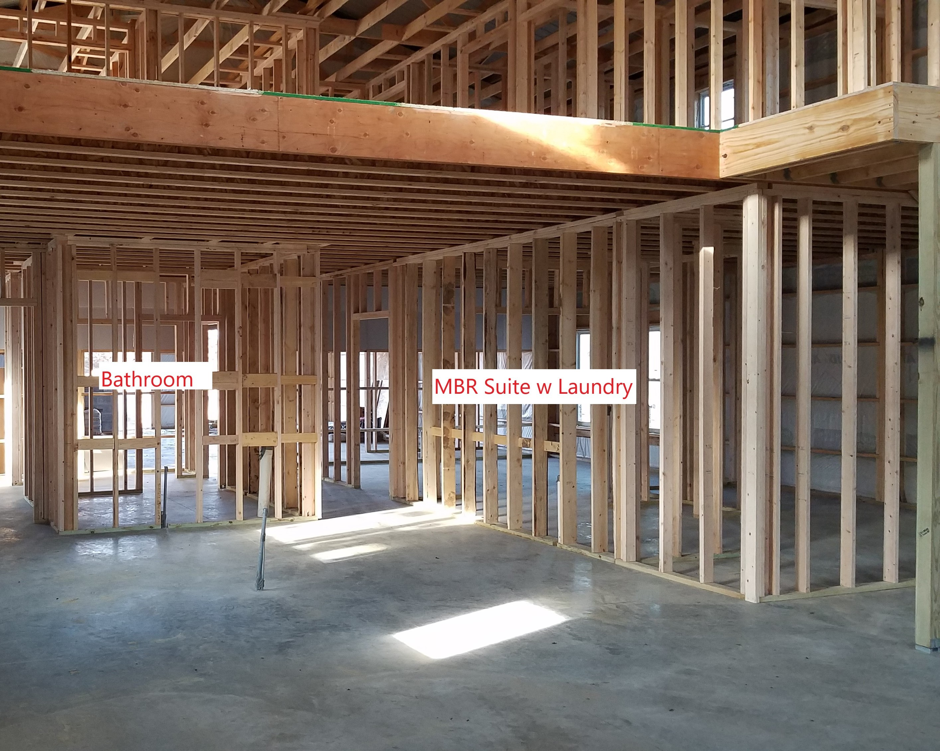
Light Frame Construction
Mass Timber

Slide 7
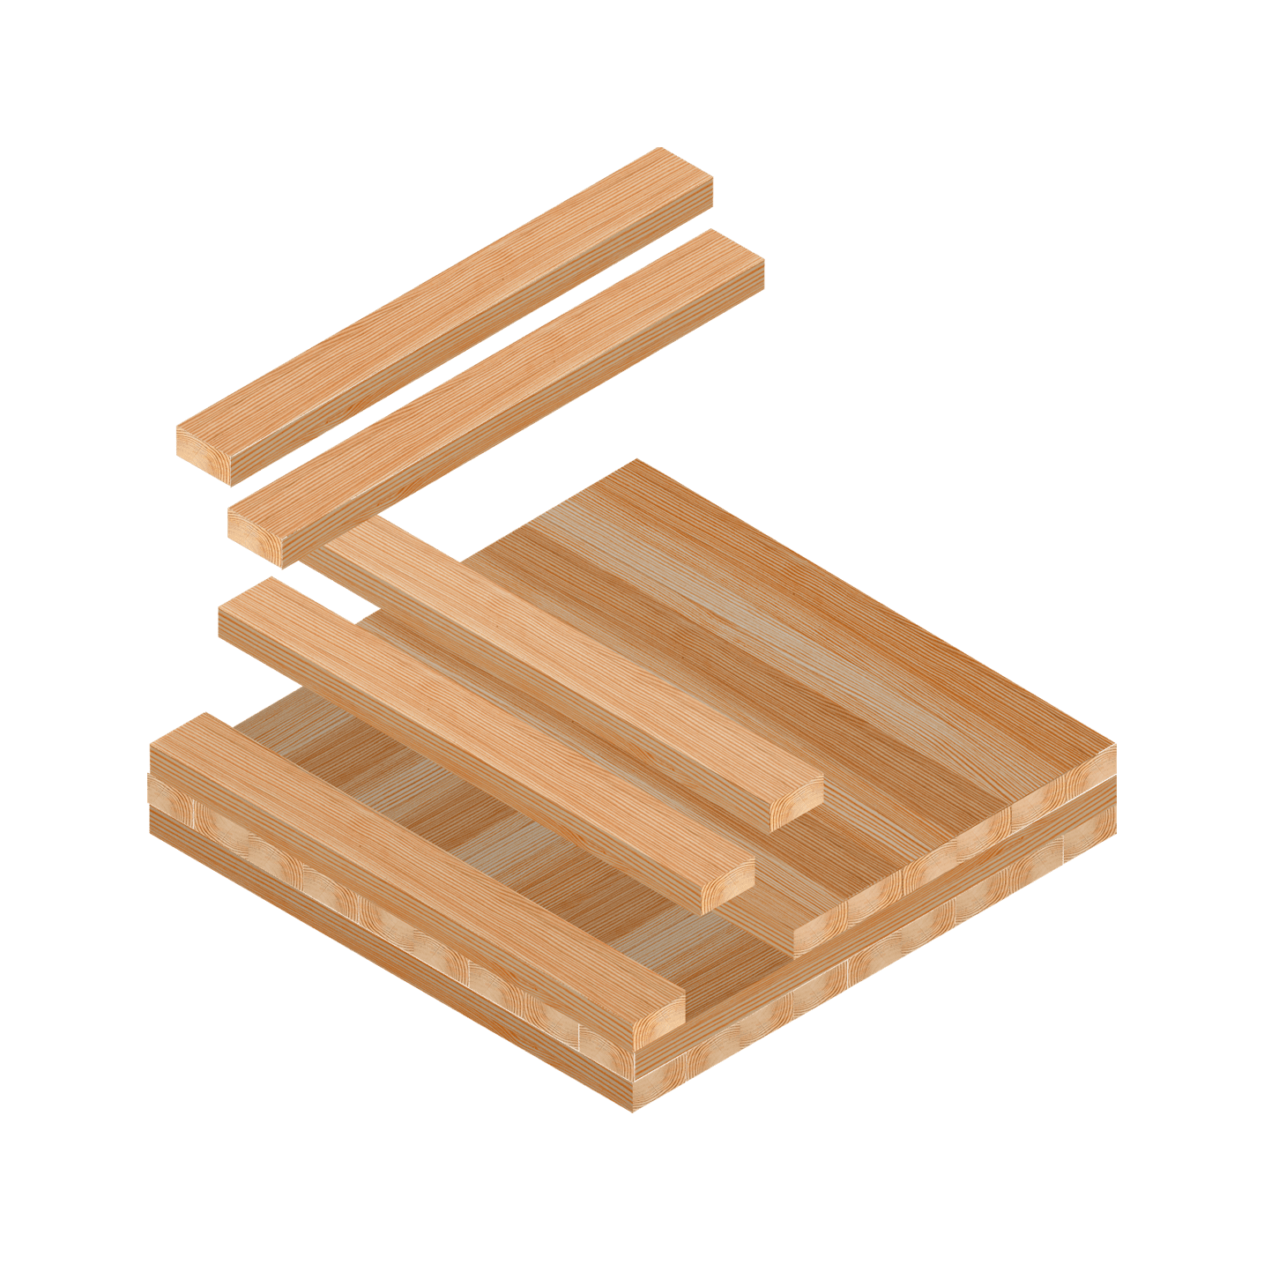
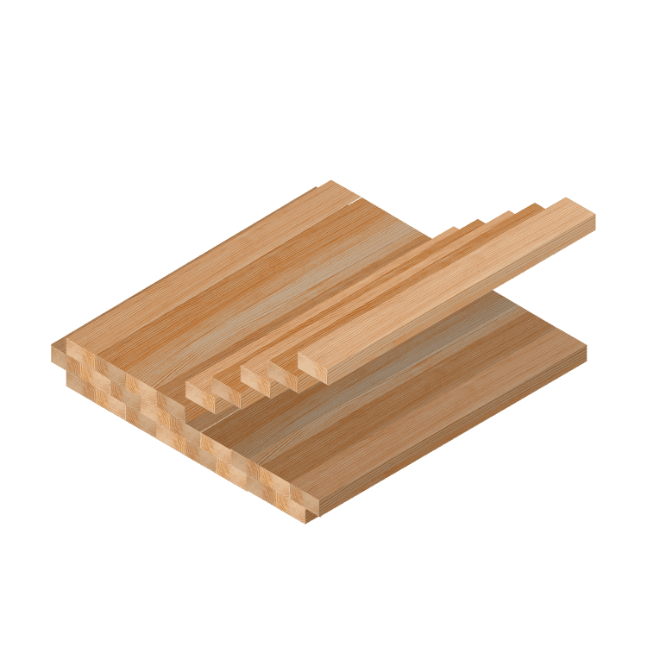
How is Mass Timber Different than Light Frame
Examples of Mass Timber products:
Cross Laminated Timber (CLT)
Gluelam

Slide 8
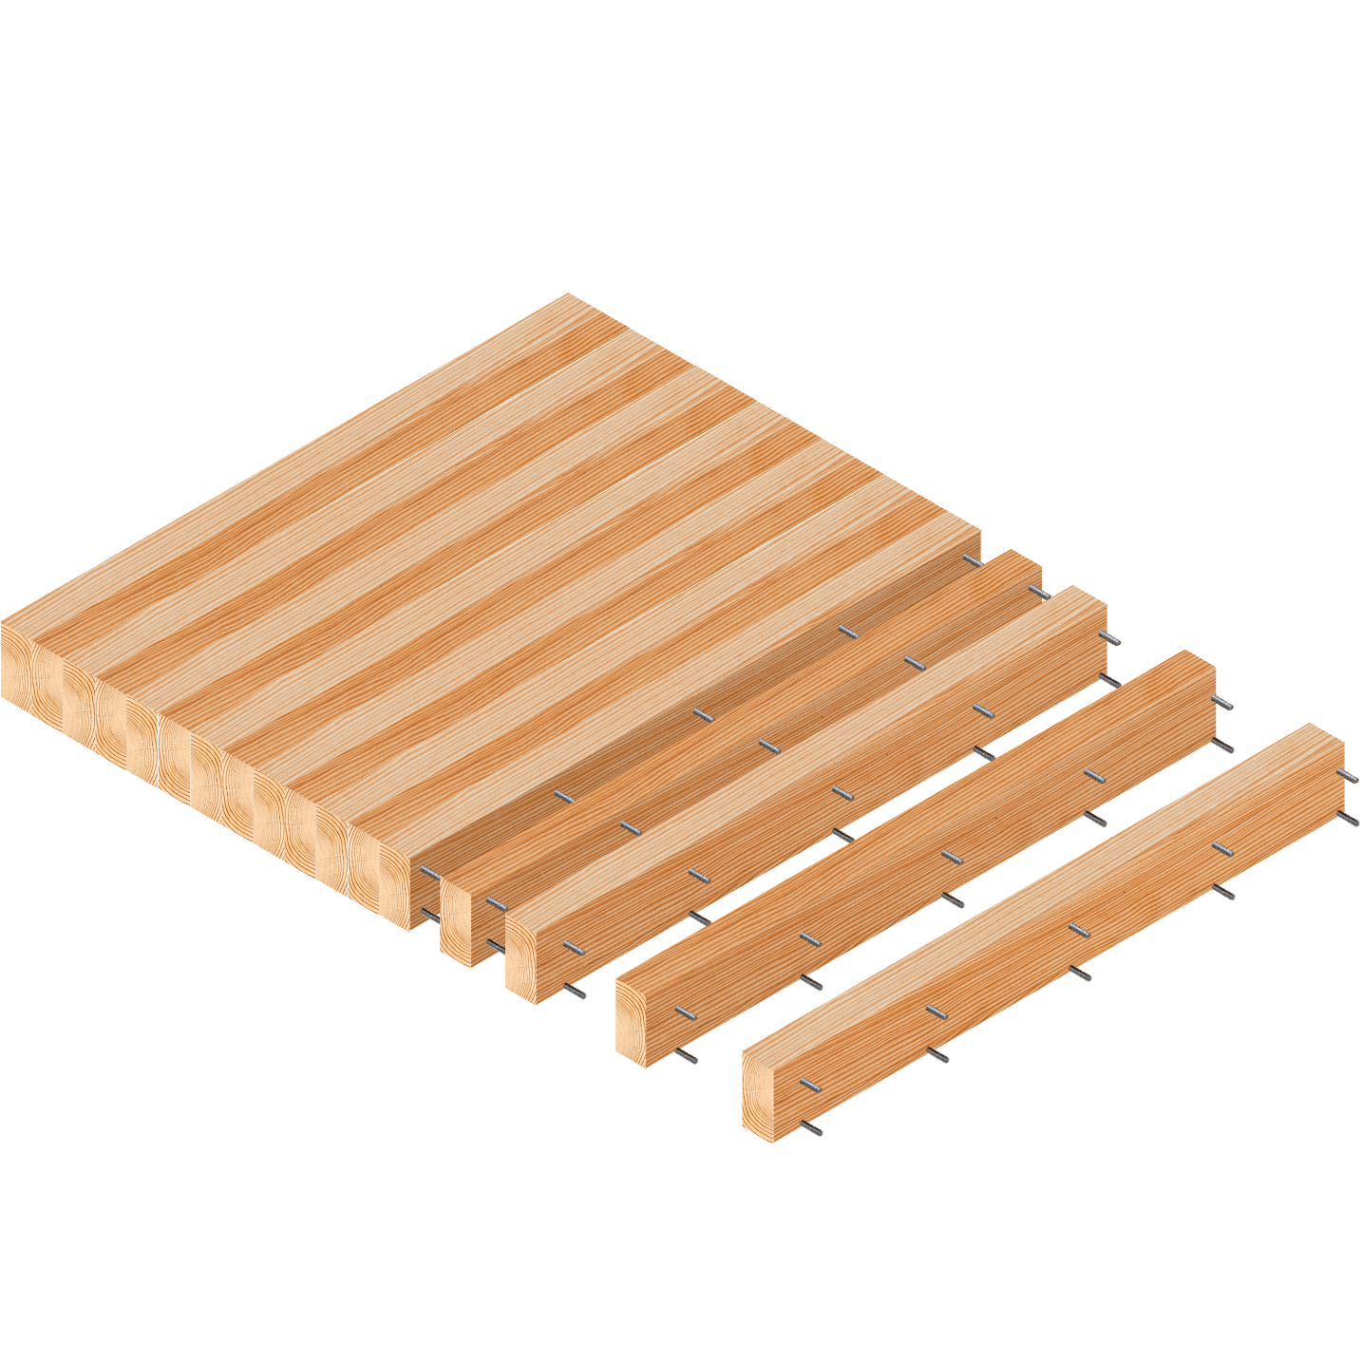
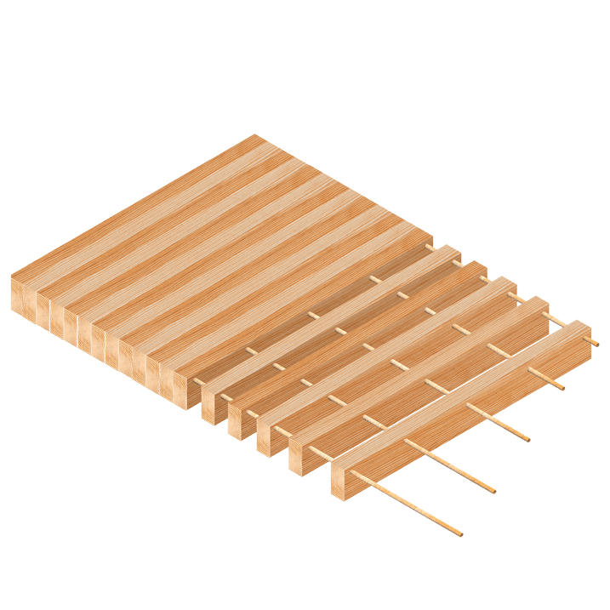
How is Mass Timber Different than Light Frame
Examples of Mass Timber products:
Nail Laminated Timber (NLT)
Dowel laminated Timber (DLT)

Slide 9
Advantages of Mass Timber Construction
Decreased Weight
  Compared to steel and concrete structures, the Mass Timber structures have a much lower weight. The lower weight provides two benefits:
    The lower weight means a smaller foundation is needed to support the building, which reduces cost and reduces the concrete needed to build the foundation.
    The reduced weight means less mass, which increases the building’s earthquake resiliency.
    Mass timber will sometimes be used to add stories on top of an existing building due to its reduced weight.
Sustainable and Renewable Materials
  According to the APA – THE ENGINEERED WOOD ASSOCIATION more than one billion trees are replanted every year (about three million per day. Each year about 27% more timber is planted than is harvested. Mass Timber beams and panels are laminated from smaller pieces of lumber and, therefore, do not need to be made of old-growth trees.
  The APA also says that the manufacturing of wood products account for 47% of all industrial raw material manufactured in the United States, but only consumed 4% of the energy needed to manufacture all industrial raw materials.

Slide 10
Advantages of Mass Timber Construction
Carbon Footprint
  The carbon footprint of a building is the amount of carbon dioxide it produces during all of its operations and activities through the entire lifecycle of the building.
    The footprint considers all activities and materials needed to build the building, all operations to heat, cool and light the building during its lifetime and even the activities needed to remove the building at the end of its lifecycle.
  Compared to steel and concrete construction, the carbon footprint of wood construction (both Frame Construction and Mass Timber) is less. This lesser footprint comes from two areas:
    The mining and manufacturing processes for steel and concrete are energy intensive compared to wood’s limited energy needs from logging and sawmill operations.
    The wood used in Mass Timber keeps the carbon it has gathered as it was grown.
      Carbon stays sequestered in the wood for as long as the building exists, and possibly much longer if the wood is repurposed or reused when the building is torn down.
      Only if the wood is burned or allowed to decay will the carbon be released back into the environment.
      Thus, the larger the inventory of wooden structures in the world, the more CO2 is sequestered and kept from impacting the environment.
      Carbon sequestration is an off-set to the other factors used in the carbon footprint calculation.

Slide 11
Advantages of Mass Timber Construction
Off-Site Fabrication
  The structural components are fabricated using computer numeric control, or CNC machines, which are capable of exceptionally tight tolerances, as little as ± 1/16-inch. These tight tolerances lend themselves to a “kit” type of construction process.
    Think IKEA
  The pieces of the “kit” can be delivered in the proper sequence with just-in-time delivery.
  The components can even be place on the semi-truck’s flat-bed trailer in the correct order so that the next piece is on top of the stack and ready to be crane hoisted into place.
  Similar to your IKEA end table, the pieces mate up flawlessly, with holes aligned to allow a small crew to put together the buildings structure quickly.
  The quick build allows the building to be enclosed much quicker than in traditional steel or concrete buildings. Less time to put up the building and a smaller construction crew both mean less labor costs.
    Check out this link to a time-lapse video showing the completion of an 18-story student residence at the University of British Columbia. Start to finish of the structure was only 9 ½ weeks. Brock Commons Time Lapse – University of British Columbia
      https://www.youtube.com/watch?v=GHtdnY_gnmE
    Advantages of Mass Timber Construction – From Mich St Univ. Video
      https://www.youtube.com/watch?v=BknDpL70BS8 (Time: 3:05)
    CNC Machining of Timber Frame: https://www.youtube.com/watch?v=HJImweAmOjQ&t=67s

Slide 12
Advantages of Mass Timber Construction
Thermal Performance
  Soft wood, such as the pine, spruce or fir used in Mass Timber products have about 10 times the thermal insulating ability of concrete and masonry and 400 times that of solid steel. Therefore, Mass Timber does not need a thermal break between the structural and exterior envelope.

Slide 13
Disadvantages of Mass Timber Construction
Limited U.S. Manufacturing Capacity
  Much of the U.S. manufacturing capacity for Mass Timber components are in the Northwest and Southeast.
    Structurlam has built a new facility in Conway, Arkansas with it’s first major project being a new Wal-Mart headquarters near there.
    Canada, especially British Columbia, has more manufacturing capacity.
  This limited capacity adds transportation and logistical costs to projects located in other parts of the U.S.
Project costs for Mass timber are higher.
  Similarly sized concrete or steel buildings are cheaper. Recent reports have shown cost to be closer or even with steel and concrete.
  The reduced labor costs for Mass Timber discussed earlier are a driver for these reductions.

Slide 14
Disadvantages of Mass Timber Construction
Limited Expertise
  Engineering and design time for Mass Timber is longer
    The need for very complete and detailed plans due to the off-site CNC manufacturing moves much of the fabrication work from the trades people on site to the designed and computer aided drafting people in an office.
  Building Information Modeling (BIM) is a key component of the building process. Smaller general and trade contractors are not up to speed on BIM.
  The lead architect on the Ascent building in Milwaukee, Jason Korb, had never built a Mass Timber building before starting that world record setting building. In an interview, he estimated he only knew about 5% of what he needed to know when that project began.
  On the plus side, Woodworks – The Wood Products Council has a staff of engineers and construction professionals that will consult with project development teams on individual commercial and multi-family projects. These services are provided free of cost.

Slide 15
Disadvantages of Mass Timber Construction
Building codes in many jurisdictions are not up with the current codes
  The 2021 International Building Code (IBC) includes provisions for up to 18 stories of Mass Timber construction for commercial and multi-family residential occupancies.
    The 2021 version of the IBC has only been adopted in about 20% of the states, either in whole or with amendments.
    New York City is still on the 2009 IBC, which limits Mass Timber to only 6 stories. There is speculation NYC may move directly to the 2021 IBC in the future, but no timeline given.

Slide 16
Disadvantages of Mass Timber Construction
Knowledge lacking in insurance and financing of Mass Timber projects
  Developers are finding it hard to obtain builders risk and, to a lesser extent, property policies for Mass Timber projects and buildings.
    Insurance Services Office (ISO) continues to classify Mass Timber as Frame Construction – more on the fire ratings coming up later in the presentation.
  Mass Timber projects have a much different cash-flow pattern than seen in other types of construction.
    The materials delivered to typical construction sites are basically raw materials, while the beams and panels in the Mass Timber structure come to the site with significant manufacturing input already imbedded in the value of the materials delivered.
    There is also a higher professional input costs early in the project so that the plans are fully developed before a board is cut.

Slide 17
Mass Timber Fire Rating
Mass Timber has been proven to meet code requirements through extensive research and testing.
Mass Timber Fire Resistance tests have shown that these structural elements become charred. This charring acts as a insulating layer, protecting and slowing the destruction of the mass timber elements.
Testing has shown consistency in the rate of burn that allows the time standards for code requirements to be met.
A five-ply CLT panel (7 inches thick) showed its ability to carry load for 3 hours and 6 minutes, far exceeding the 2-hour standard needed.
  In this test temperatures of up to 1,800 degrees were reached.

Slide 18
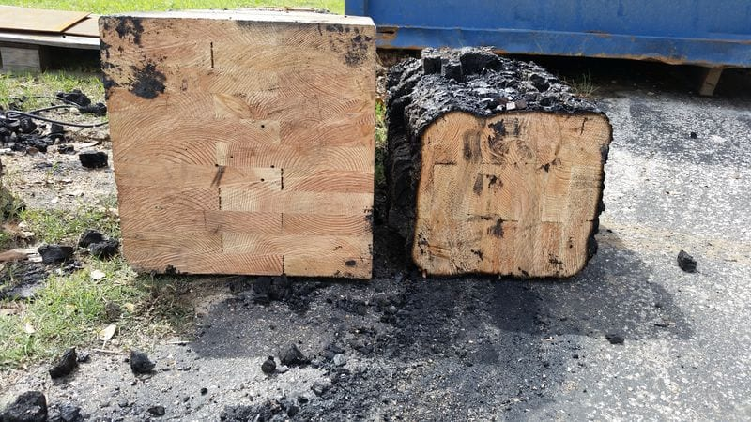
Char Layer in Fire Resistance Testingz

Slide 19
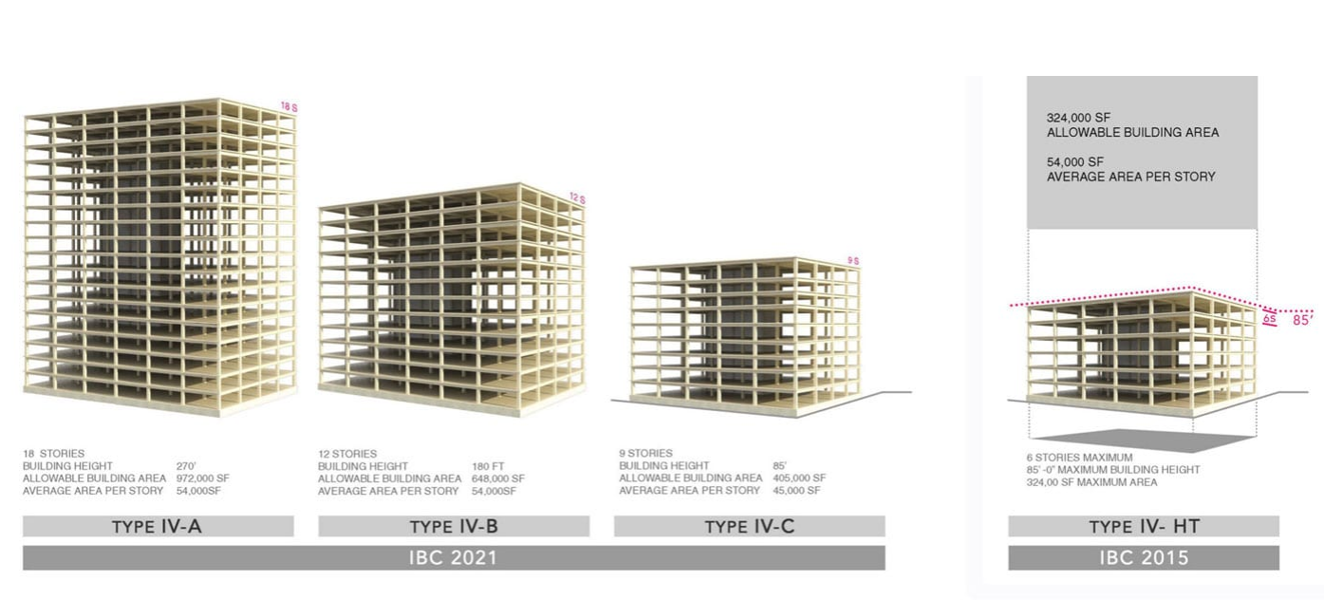
IBC 2021 and Mass Timber Construction

Slide 20
Design Challenges
Designing for Differential Movement
Acoustics within a space
Floor vibration
Repairability

Slide 21
Lessons from 111 East Grand Project
The team of architect, engineer and general contractor provided guidance to the city of Des Moines throughout the approval process.
  The city welcomed the guidance, and
  This sped up the approval process.
The T3 building in Minneapolis was a nearby example of a Mass timber building and helped to solidify the decision to use Mass Timber for the project.
The team of architect, Engineer and General Contractor relied heavily on Building Information Modeling (BIM) throughout the process.
  The BIM models were combined with other models from trade contractors to uncover conflicts between systems and structural members.
  Clash reports and Virtual Design and Construction meetings were used to resolve conflicts early in the process, before a single piece of lumber was cut.

Slide 22
Lessons from 111 East Grand Project
The team of architect, Engineer and General Contractor relied heavily on Building Information Modeling (BIM) throughout the process.
  The BIM models also allowed the creation of precise shop drawings for every component of the project, and for the sequencing of each component’s arrival on site.
    Having the components arrive on-site just-in-time and in the correct sequence allowed the building to be assembled with only a small staging area, which allowed the streets around the site to remain open.
    This was a big plus for the city with the East Village area of Des Moines being filled with retail shops, office space and restaurants.
The structure was erected in just 6 weeks by a crew of 8 including 2 supervisors and 6 local carpenters. It is estimated 7 weeks were saved during the erection process by using Mass Timber instead of steel or concrete.

Slide 23
Lessons from 111 East Grand Project
The developer said the occupancy projections used for this new building ended up being conservative.
  Commitments for occupancy came earlier in the building’s development, and the occupancy rates they are experiencing have been much better than initially projected. He attributes these positive outcomes to a few ideas:
    the building’s biophilic design (i.e. the design of a building that brings nature into the space) stemming from the building’s exposed wood surfaces,
    the tenant’s interest in being connected to the first of its kind building in the state, and
    the story the building tells regarding the tenant’s commitment to green environmental initiatives like sustainable materials and carbon sequestration.

Slide 24
Information Sources
Think Wood – https://www.thinkwood.com/
Wood Works – Wood Products Council - https://www.woodworks.org/
Naturally Wood - https://www.naturallywood.com/
Structurelam - https://www.structurlam.com/
Structurecraft - https://structurecraft.com/

